Slide 1
The 10 Highest causes of death in the US
DATA 101: ASSIGNMENT #2 - ALI AWARI

Slide 2
WHY STUDY The Top Causes of DEATH?
Determine which events cause the highest damage to our society.
Understand if anything can be done by the individual or government to decrease death caused by these events.
Information obtained by The U.S. Department of Health and Human Services.
https://catalog.data.gov/dataset/age-adjusted-death-rates-for-the-top-10-leading-causes-of-death-united-states-2013/resource/0e603f1d-31bf-4809-8f10-a994b305b379

Slide 3
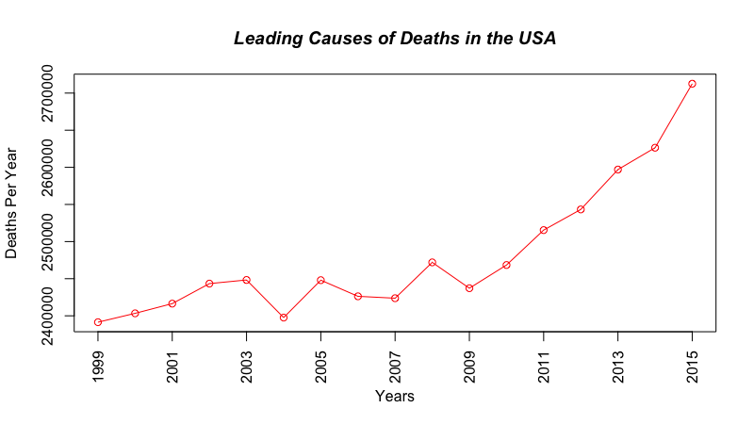
There was a plateau during 1999-2008 of the leading causes of deaths in the USA.
After 2009, there was a sharp rise in the top leading causes of death.
1. plot(annualDeaths$Year, annualDeaths$Deaths, col = "red", xlab="Years", ylab = "Deaths Per Year", type = "o", main = "Annual Deaths in the United States", font.main=4, xaxt='n')
2. axis(1, at = seq(1999, 2015, by = 2), las=2)

Slide 4
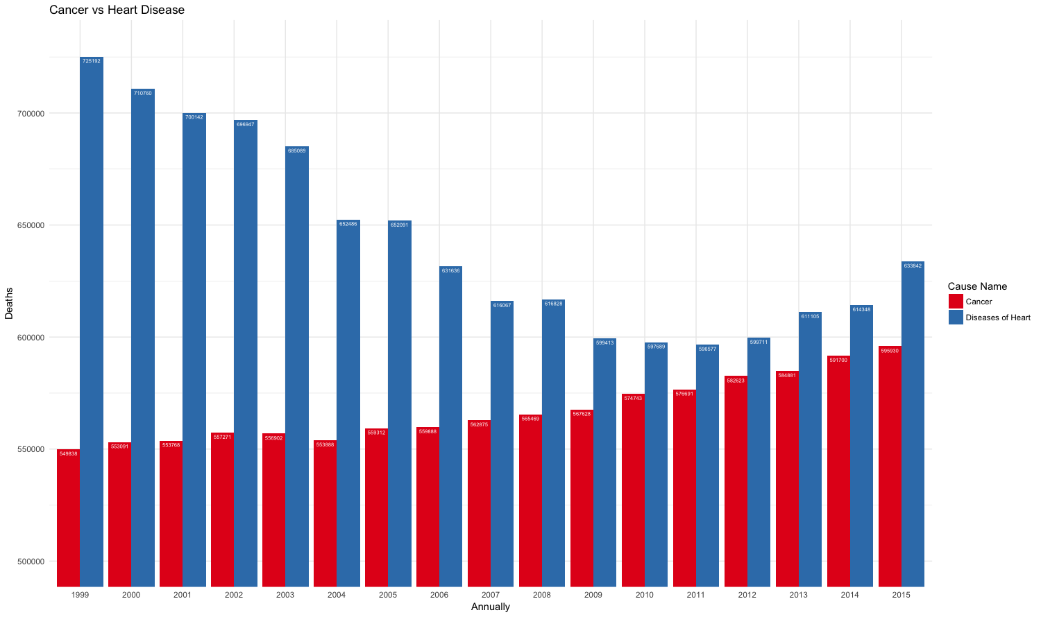
Cancer vs. Heart Disease
Two leading causes of death compared to one another
Heart Disease has decreased over 1999-2015.
Cancer has risen over the same period
1. Annually <- as.factor(Cancer_Heart_Disease$Year)
2. ggplot(data=Cancer_Heart_Disease, aes(x=Annually, y=Deaths, fill=`Cause Name`)) + geom_bar(stat="identity", position=position_dodge()) + geom_text(aes(label=Deaths), vjust=1.6, color="white", position = position_dodge(0.9), size=2)+ scale_fill_brewer(palette="Set1")+ theme_minimal() + coord_cartesian(ylim=c(500000,730000)) + ggtitle("Cancer vs Heart Disease")

Slide 5
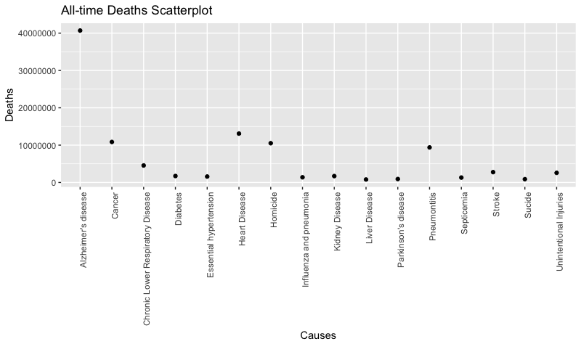
Alzheimer’s Disease is the largest All-time cause of death from 1999 – 2015
In recent years, Alzheimer’s hasn’t been in the top causes of death meaning modern medicine has advanced.
1. df <- na.omit(CauseDeath)
2. ggplot(df, aes(x=Causes, y=Deaths)) + geom_point() + theme(axis.text.x = element_text(angle = 90, hjust = 1)) + ggtitle("All-time Deaths Scatterplot")

Slide 6
Conclusion
Due to the advances in modern medicine, the total amount of deaths caused by Heart Disease and Alzheimer’s Disease has decreased significantly over the time period of 1999 – 2015.

